Slide 1
Infosys Stock Price Prediction
P-315

Slide 2

Group-4
Group4
Mr. Clive Dominic Andrews
Mr. Yash Kalose
Mr. Pranav Bandu Ranpise
Mrs. Vaishnavi Mayur Gaikwad
Mr. Babasaheb Anil Gade
Mr. Sagar Narayan Panchbudhe
Ms. Prachi Niraj Sarve
Mentor:
Ms. Aishwarya Mate

Slide 3
Introduction
Here we will learn about the importance data science in stock market & its future importance.
With the problem statement , and the contents which we are going to discuss in further slides.

Slide 4
Business Objective
Build a model to predict the price for the said period by splitting the data into train and test set.
Find trends in short term and long term.
Impact of external factors or any events.

Slide 5
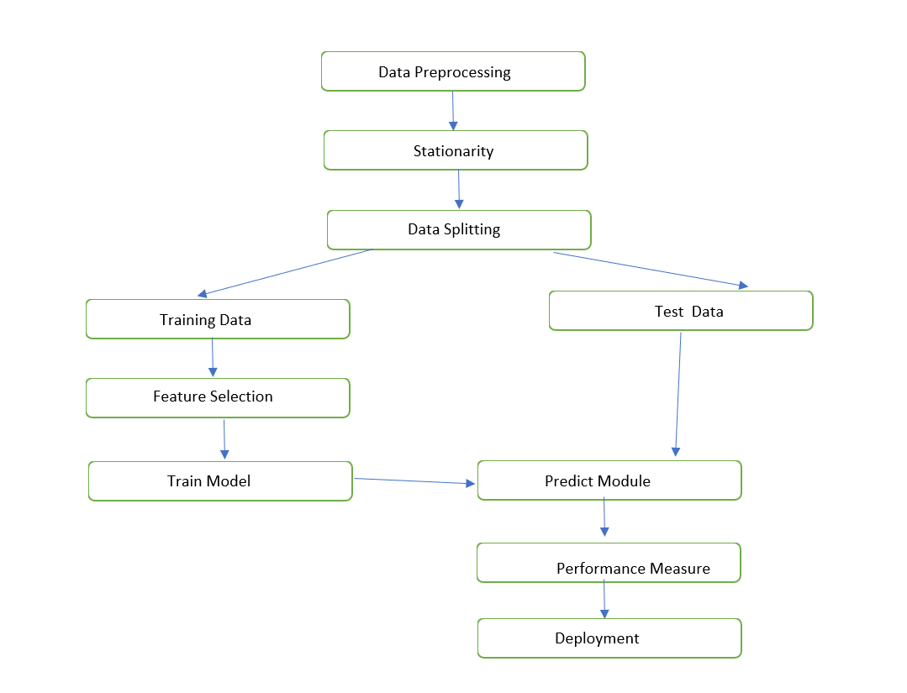
Project Work Flow

Slide 6
Data Collection and Preprocessing
We collected data from Yahoo Finance.com.Then download Infosys_BSE.csv file & took duration from 2000-2023 years.
Before training our ARIMA model, we need to preprocess and prepare the stock market data through EDA and various transformation.

Slide 7
Exploratory Data Analysis
Exploratory data analysis (EDA) is used by data scientists to analyze and investigate data sets and summarize their main characteristics, often employing data visualization methods.
EDA is primarily used to see what data can reveal beyond the formal modeling or hypothesis testing task and provides a better understanding of data set variables and the relationships between them.

Slide 8
Why is exploratory data analysis important in data science?
EDA helps data scientists gain a deeper understanding of the data & It provides insights into the structure, distribution, and characteristics of the data.
EDA helps identify and handle missing data, outliers, and inconsistencies. Cleaning the data is essential for building accurate and reliable models.
It can help identify obvious errors, as well as better understand patterns within the data, detect outliers or anomalous events, find interesting relations among the variables.
EDA allows for the identification of patterns, trends, and relationships within the data.

Slide 9
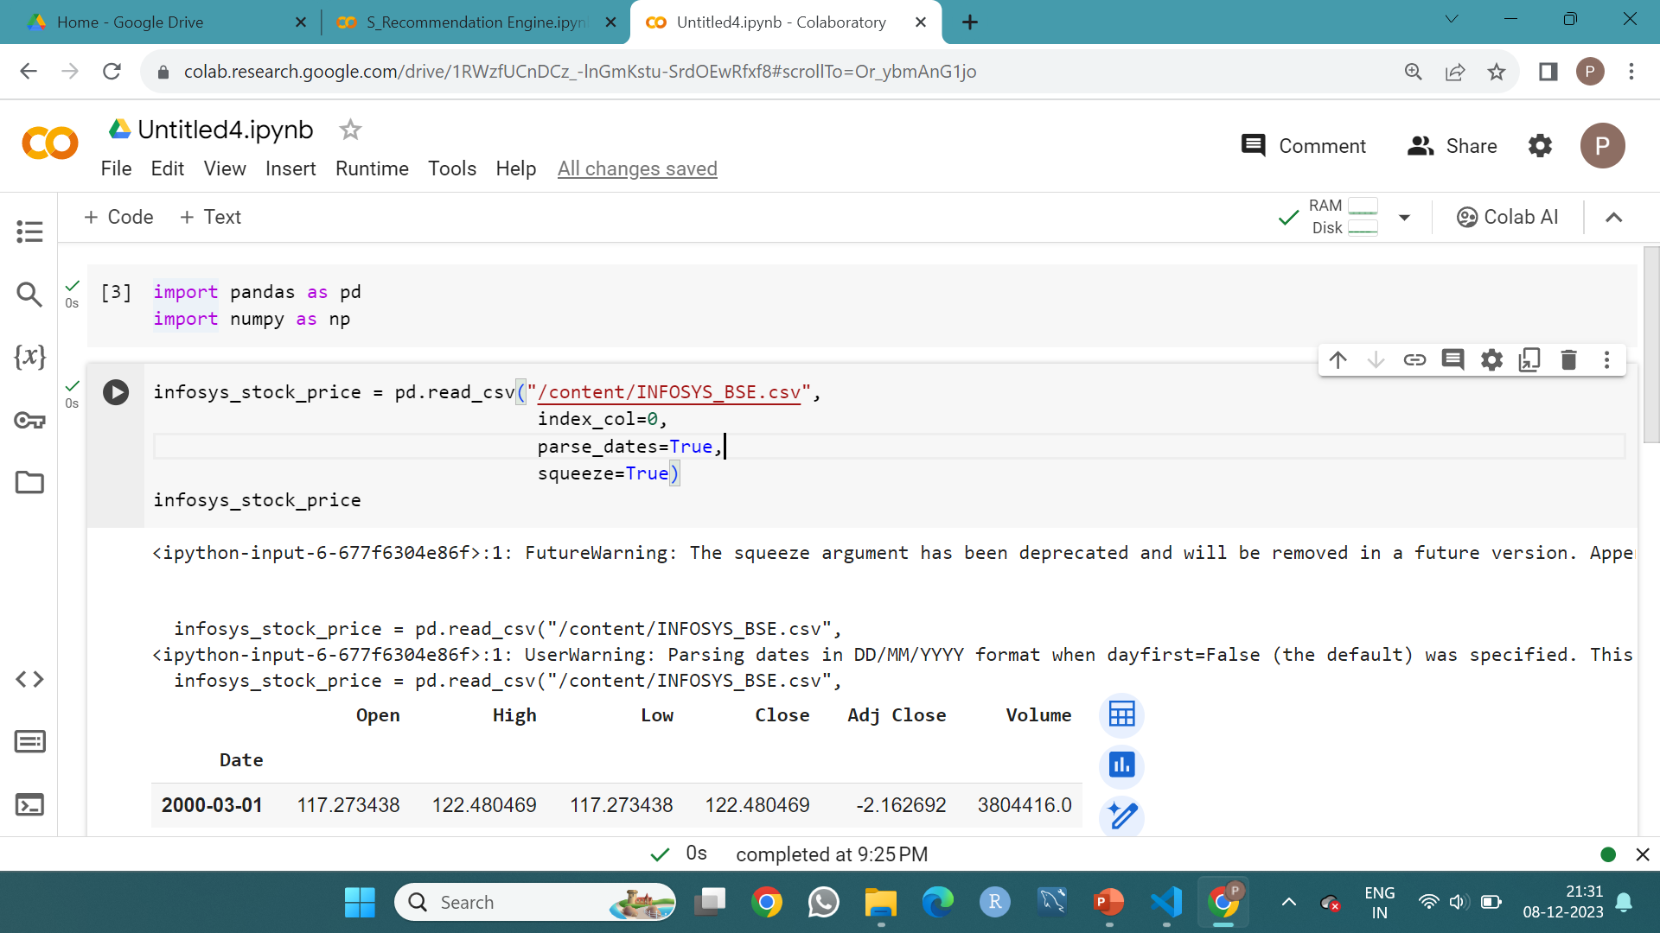
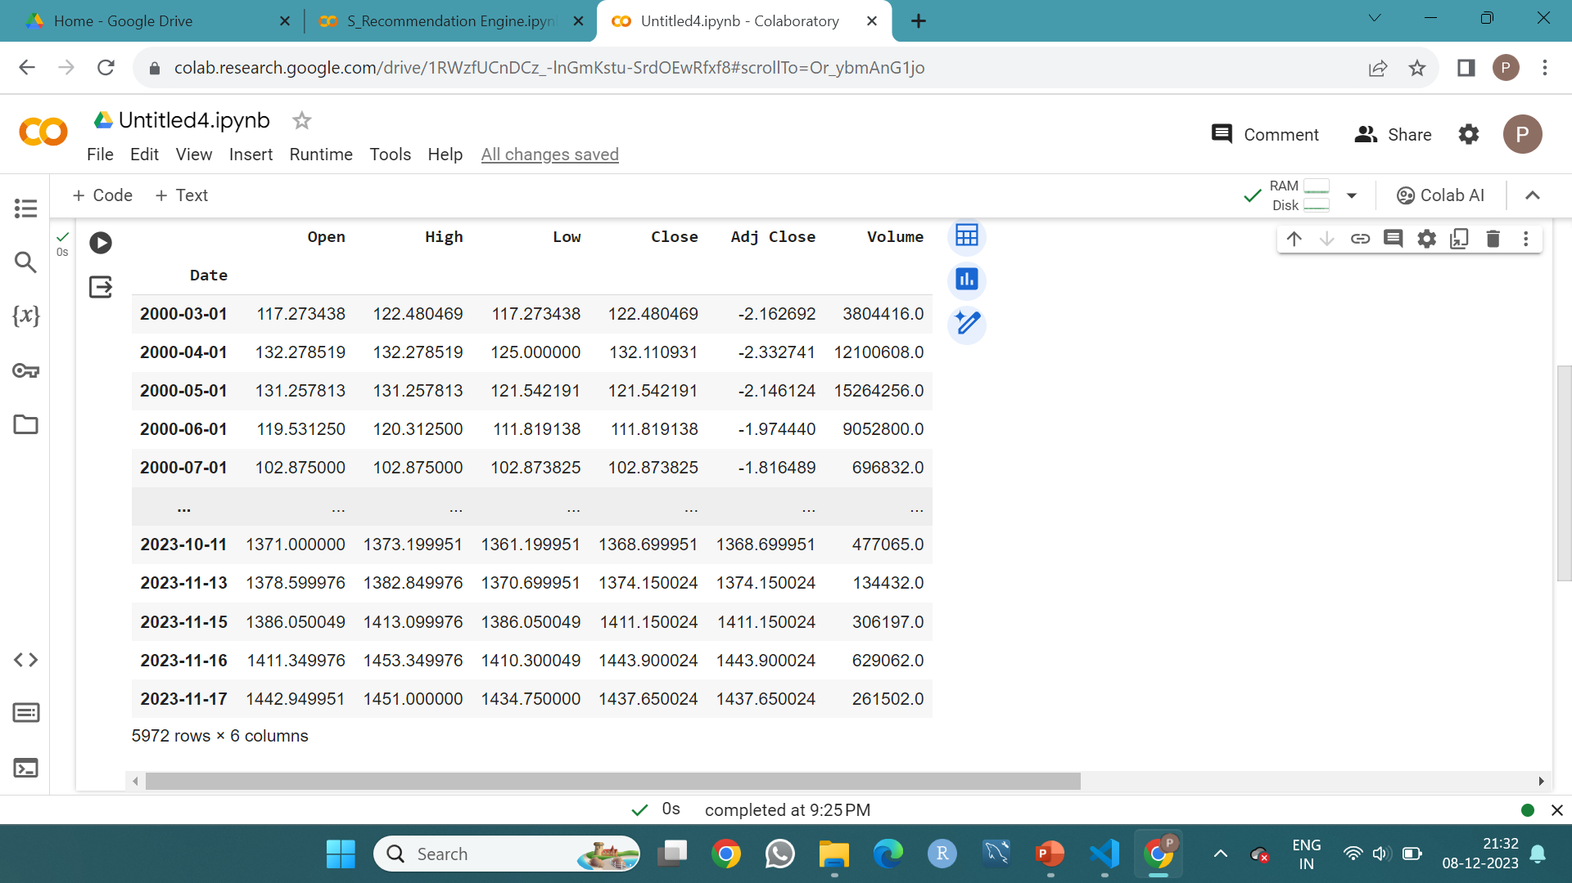
Infosys-Stock Data (2000 – 2023)

Slide 10
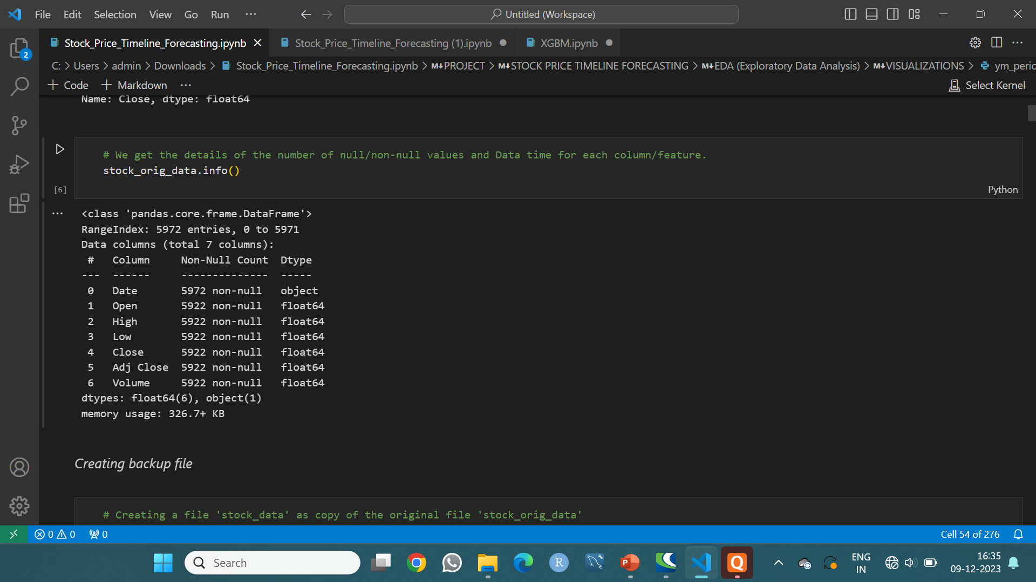
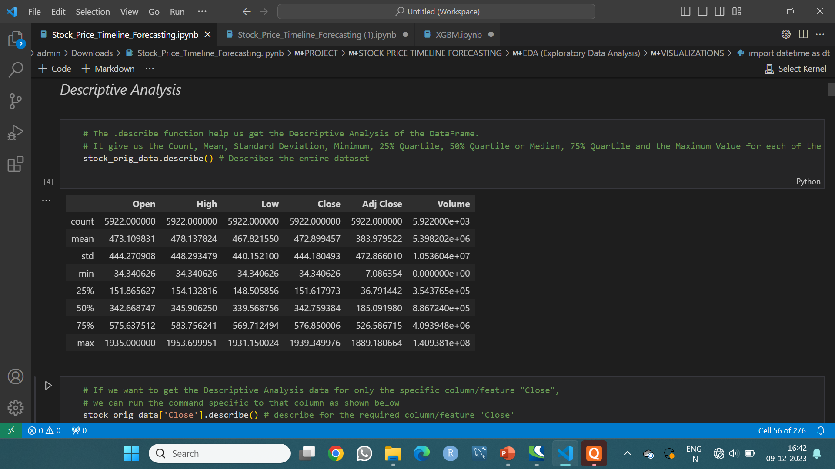
Data is checked , and there is no null value present in the dataset . Also, we got to know the datatype of the columns .
We performed all the statistics , we got to know the main values of mean, standard deviation , min-max.

Slide 11
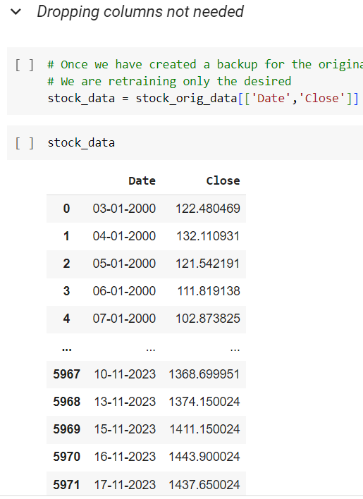
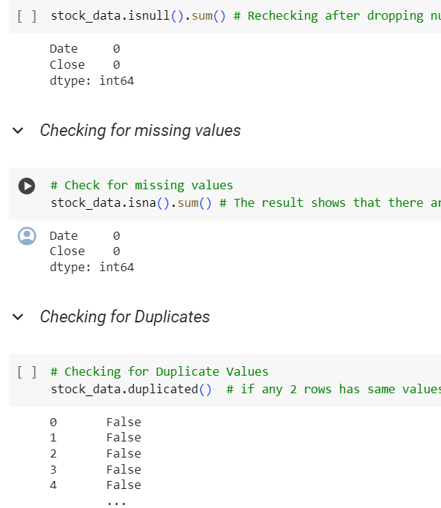

Slide 12
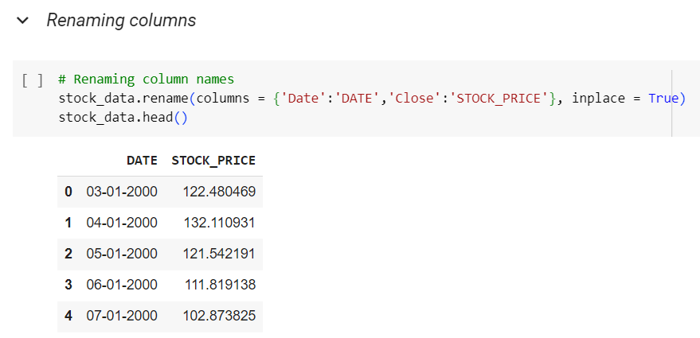
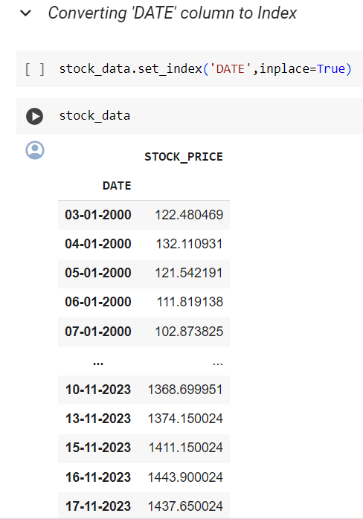
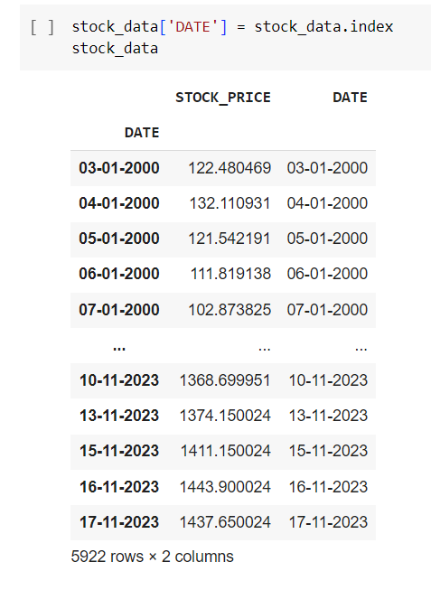

Slide 13
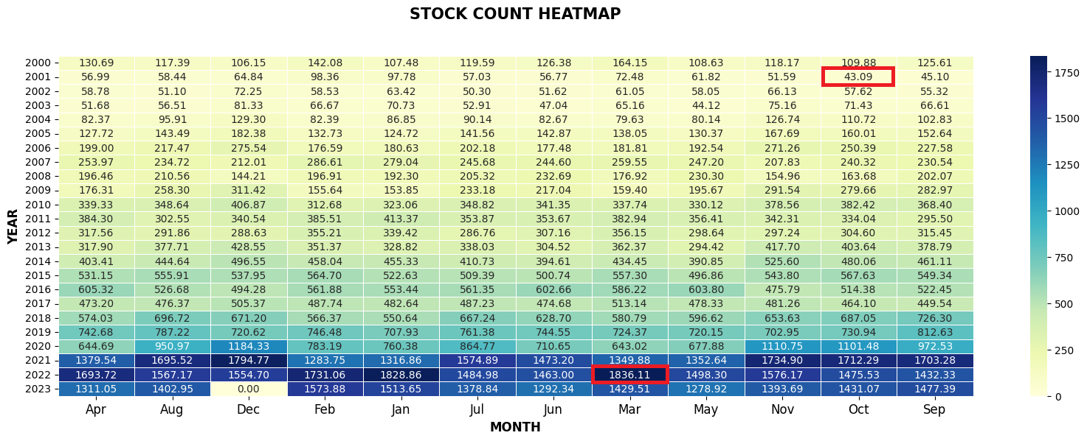
Heat Map

Slide 14
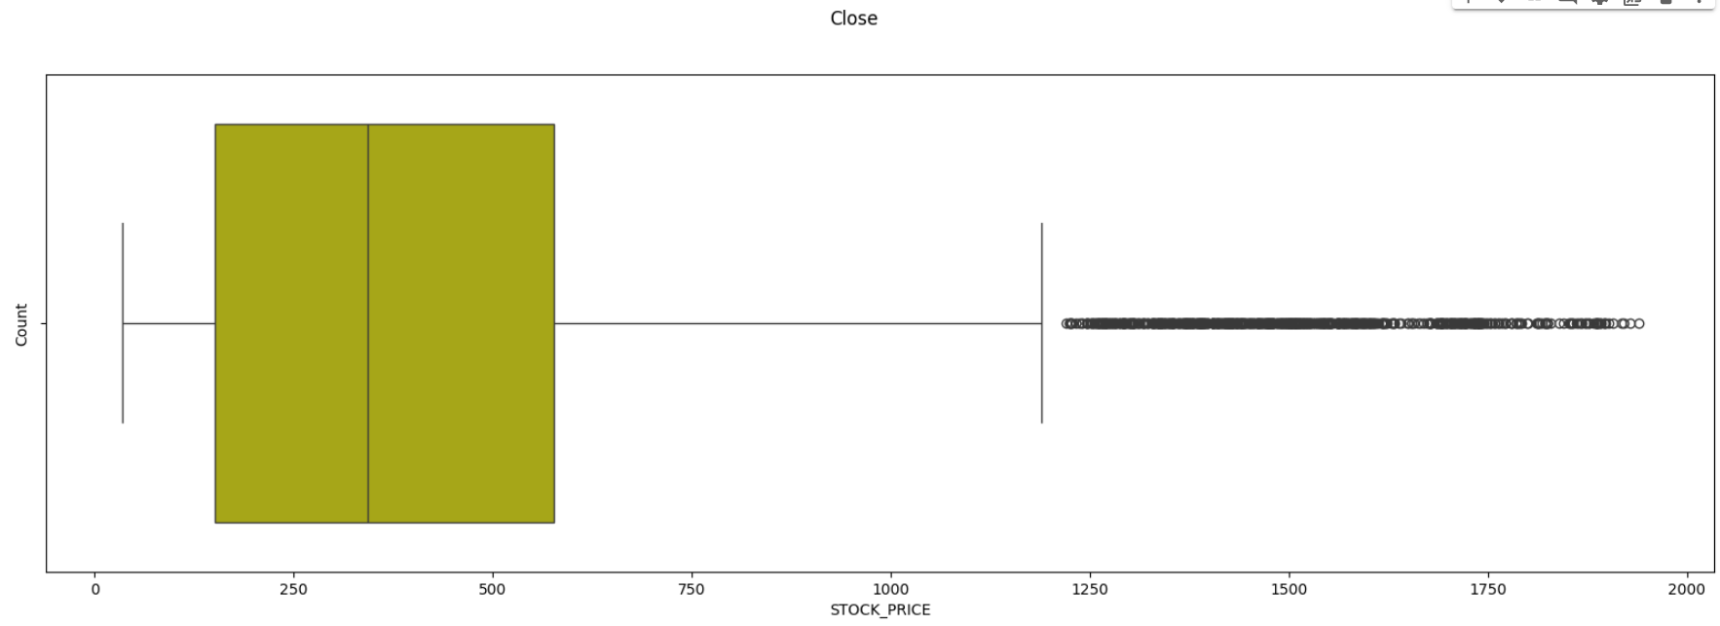
Outlier Detection

Slide 15
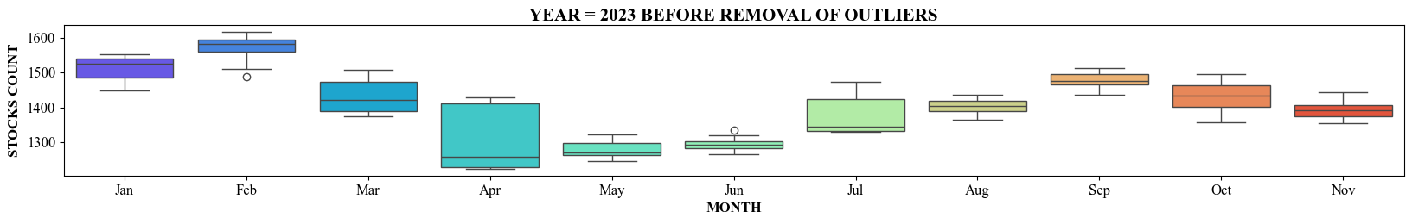


Slide 16
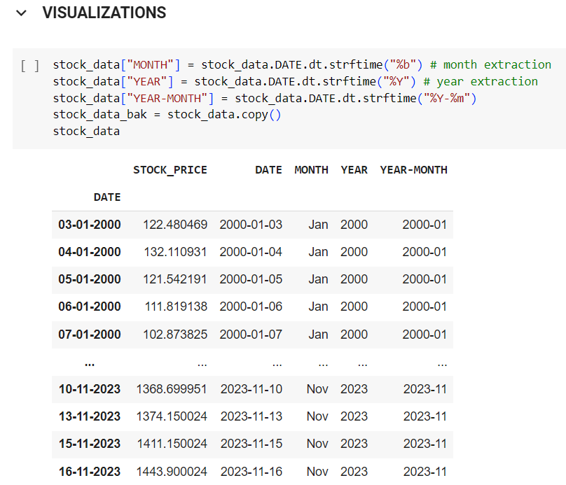
Visualization

Slide 17
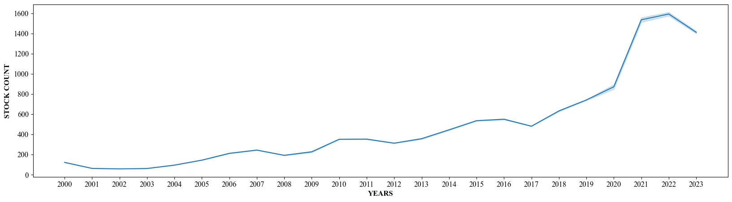
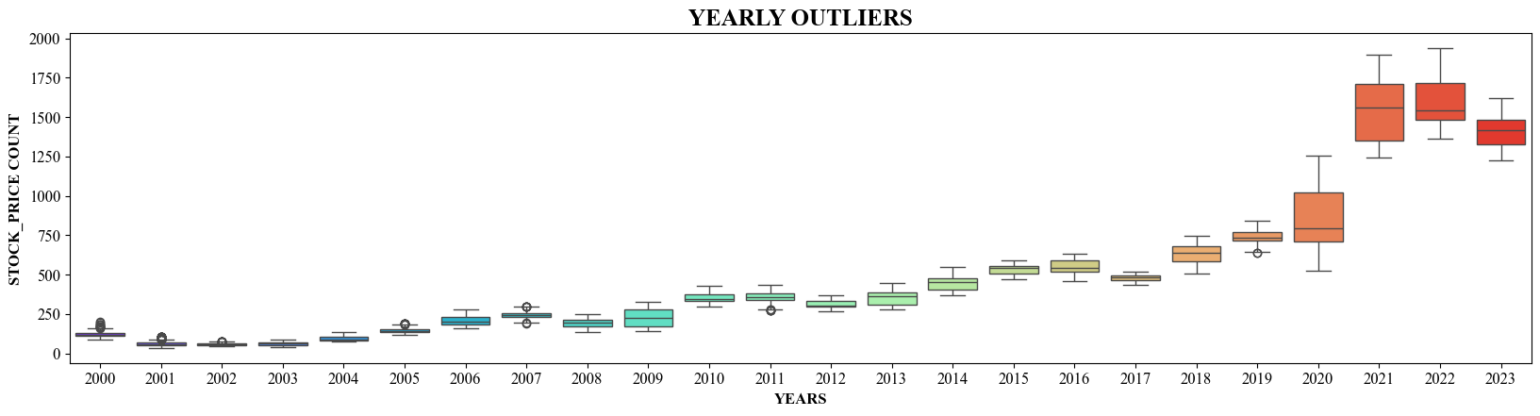
Yearwise Trend

Slide 18
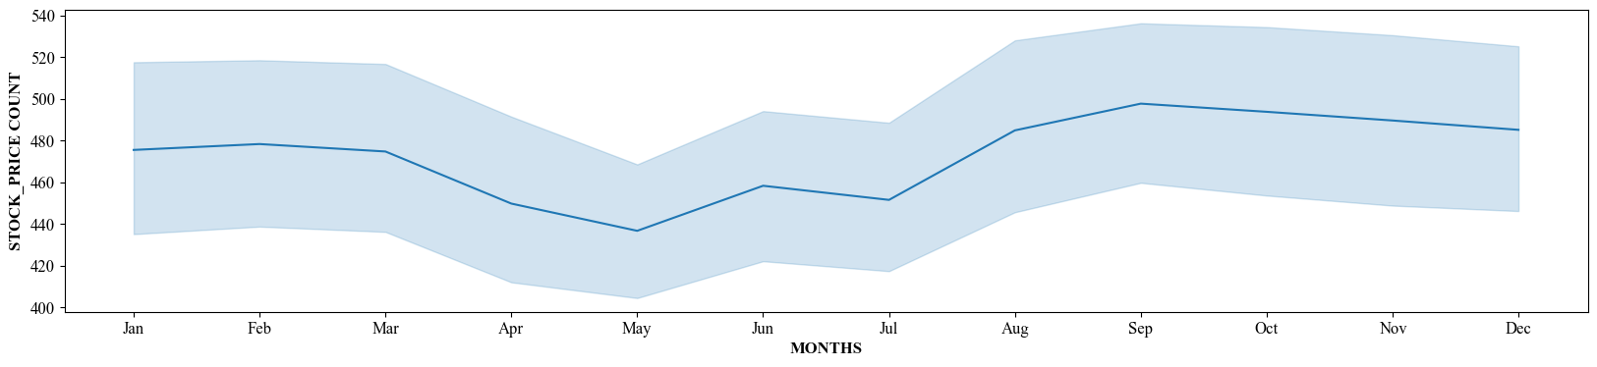
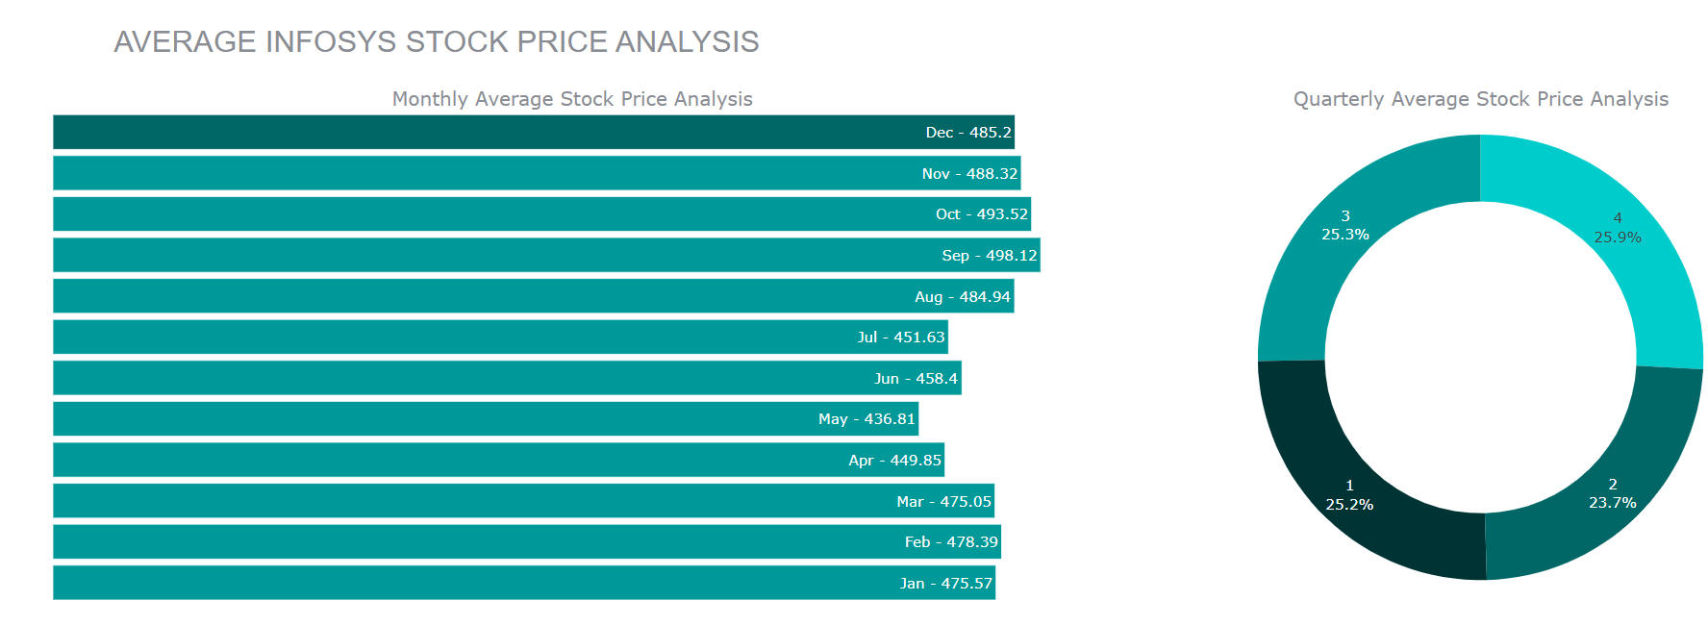
Monthwise Trend

Slide 19
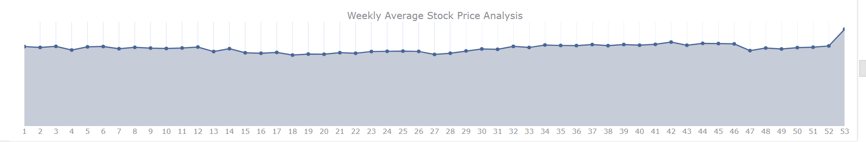
Weekwise Trend

Slide 20
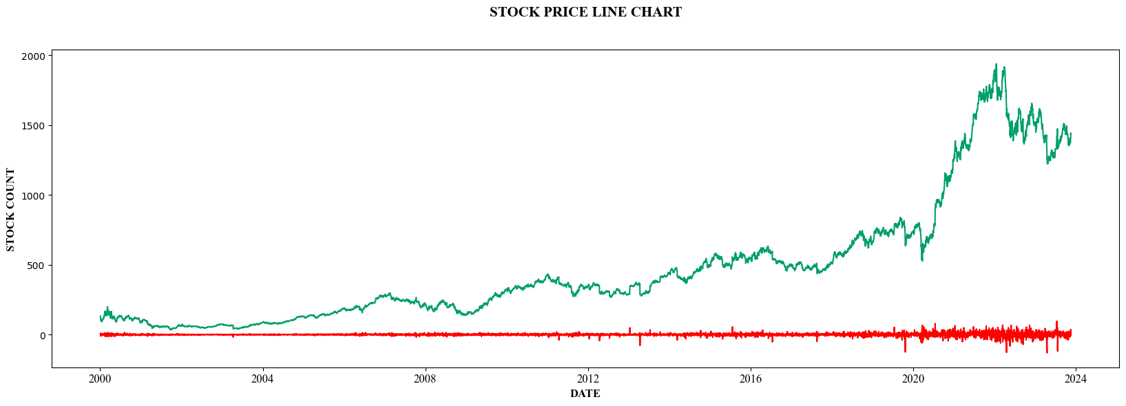
Converted data

Slide 21
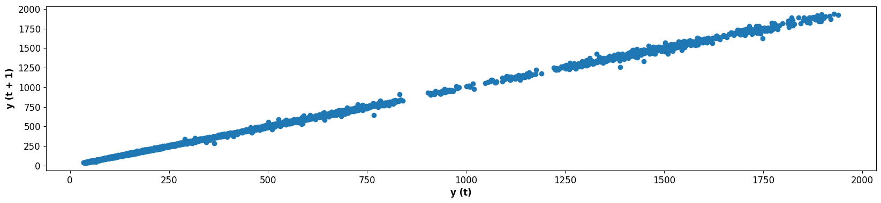
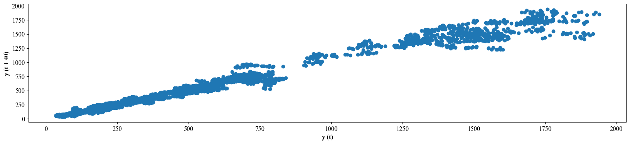
Lag Plot

Slide 22
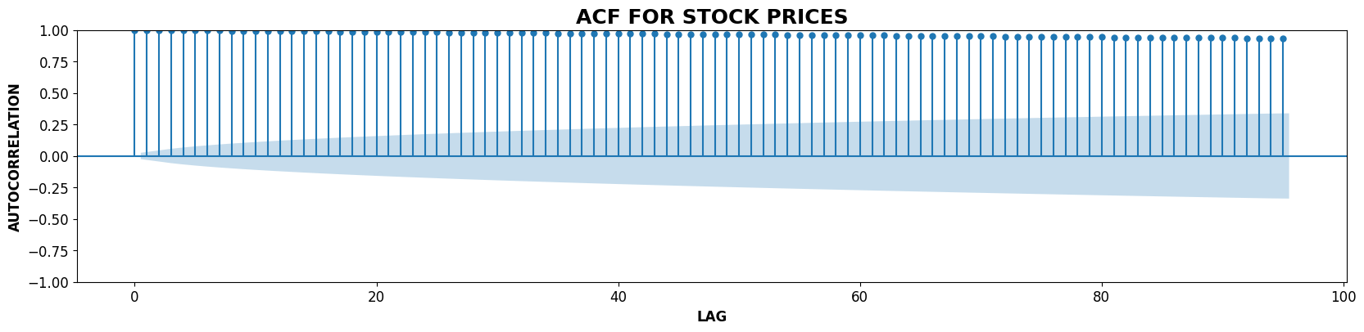
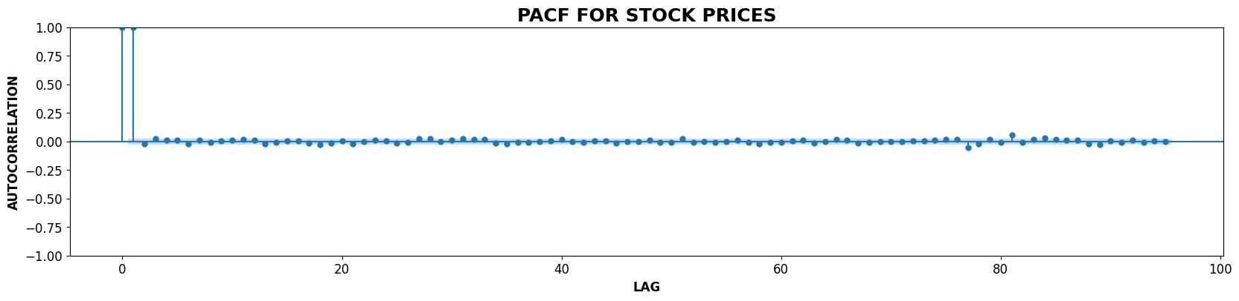
ACF & PACF Plot

Slide 23
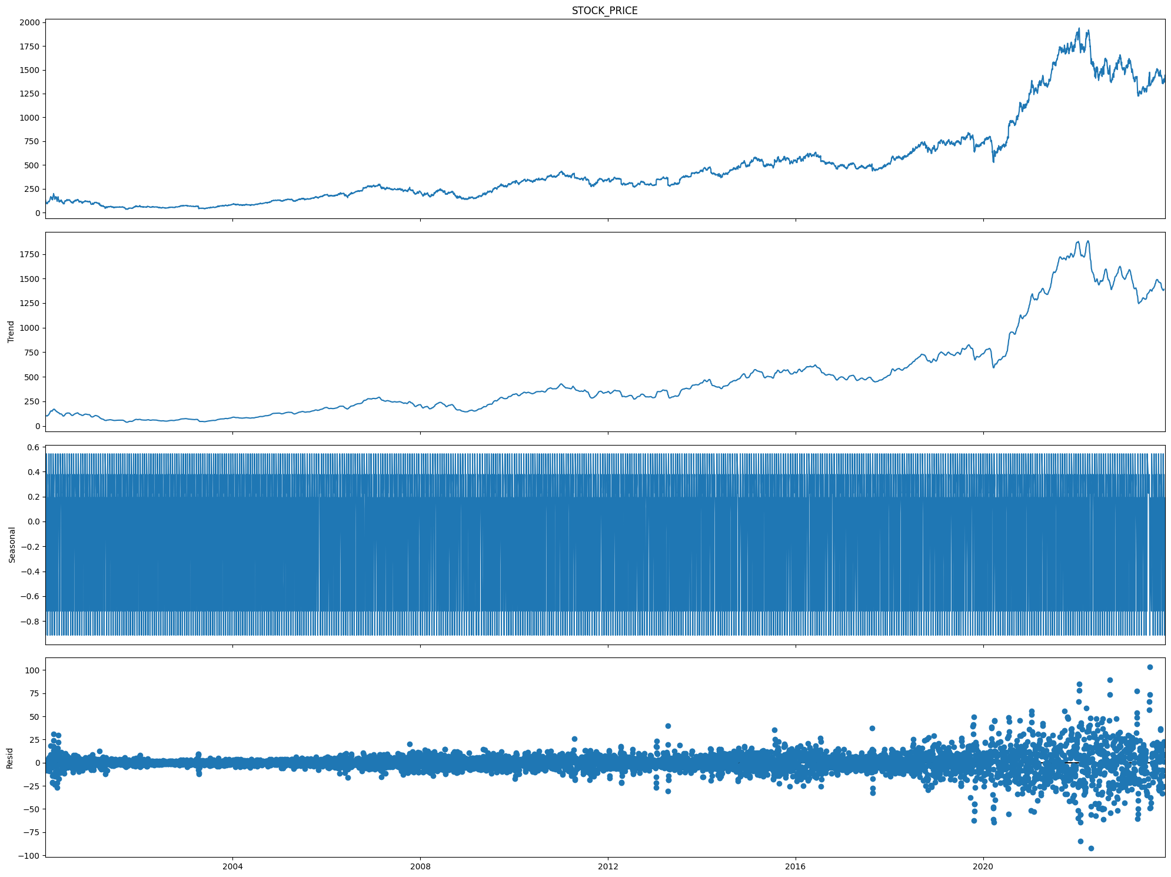
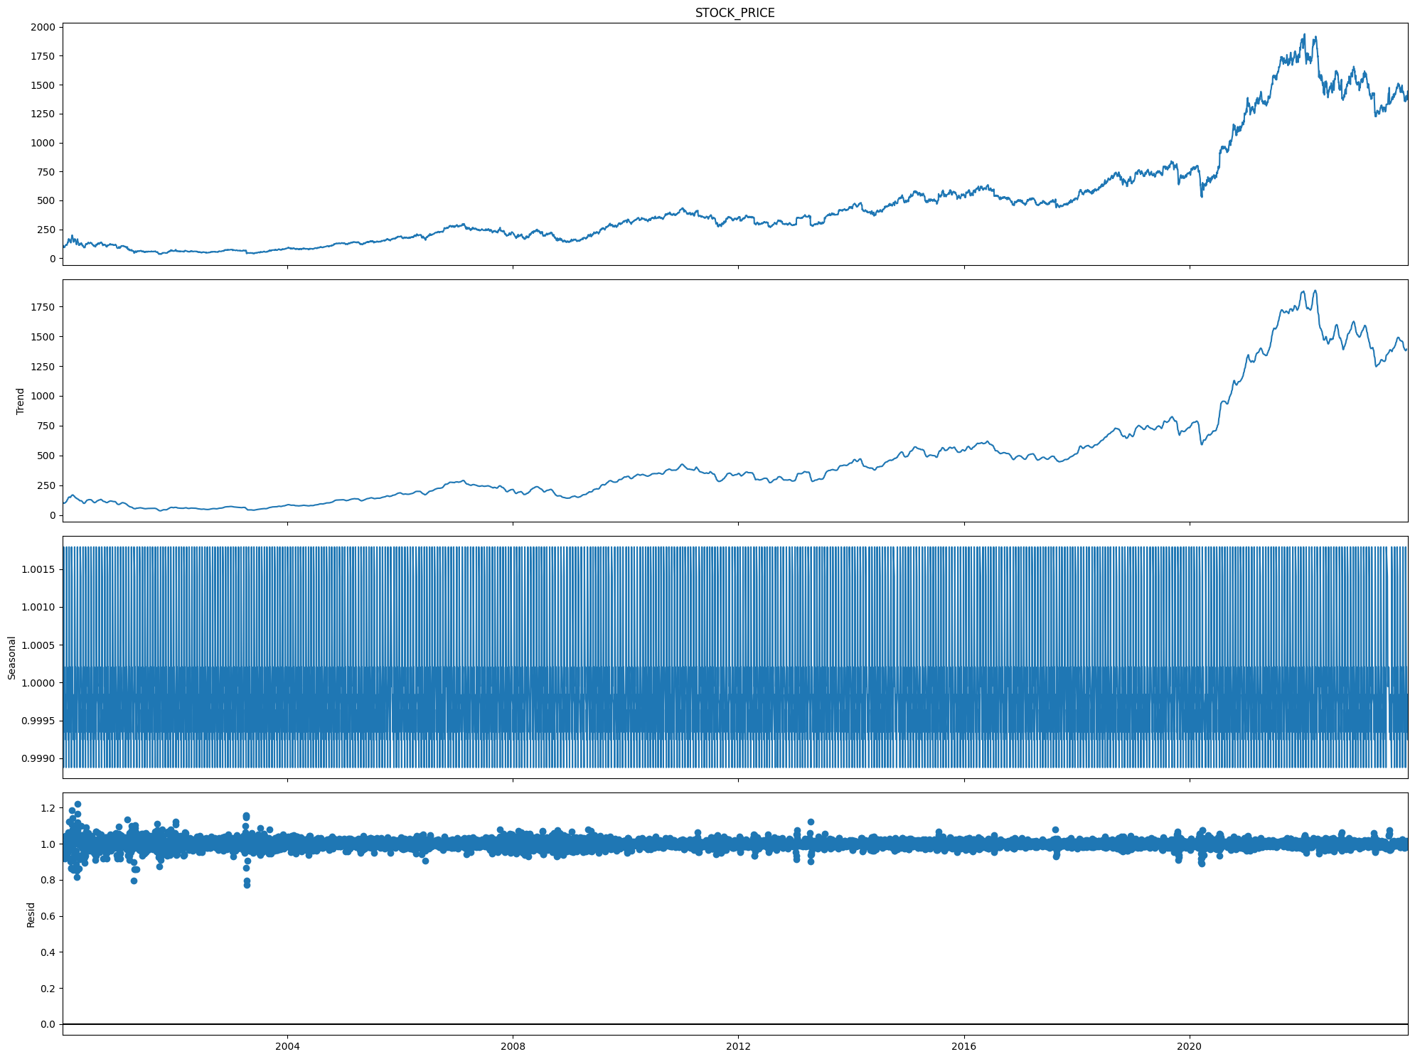
Additive & Multiplicative Seasonal Decomposition

Slide 24
Model Building
Model building is an essential part of data analytics and is used to extract insights and knowledge from the data to make business decisions and strategies.
In this phase of the project data science team needs to develop data sets for training, testing, and production purposes.

Slide 25
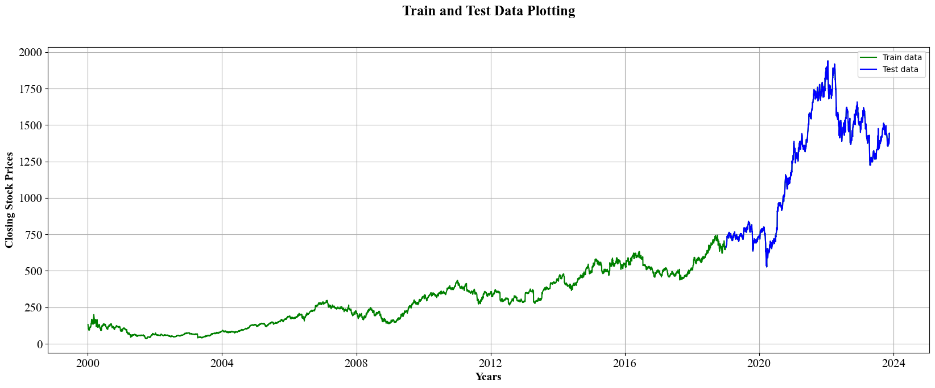
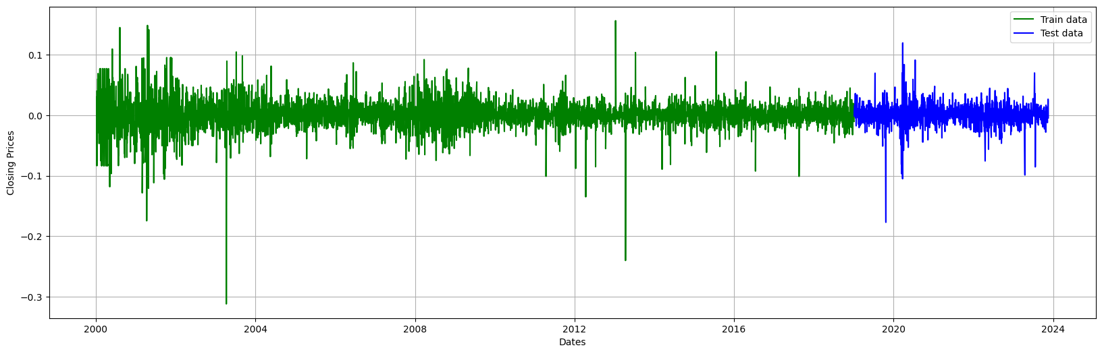
Training & Testing data

Slide 26
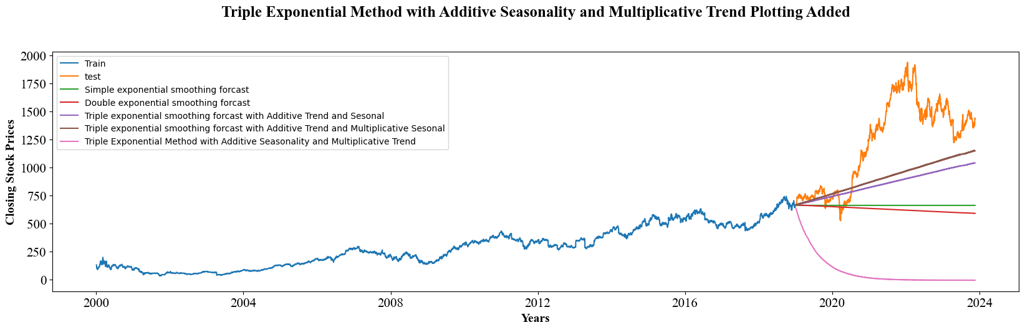
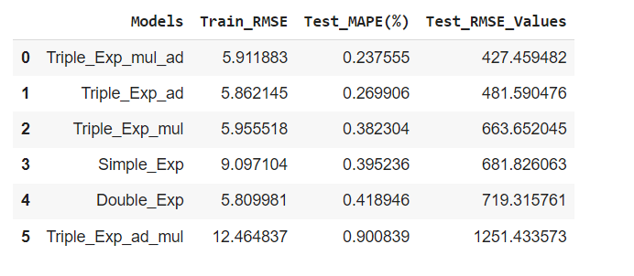

Slide 27
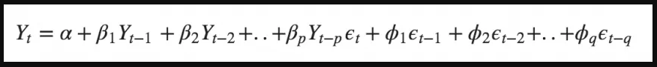
What is Arima ?
ARIMA – Auto Regression Integrated Moving Average Model.
It goes through differencing steps to eliminate the non-stationary part.
ARIMA Models are specified by three order parameters: (p, d, q),
where,
p is the order of the AR term
q is the order of the MA term
d is the number of differencing required to make the time series stationary
An ARIMA model is one where the time series was differenced at least once to make it stationary and we combine the AR and the MA terms. So the equation of an ARIMA model becomes :

Slide 28
Different Models With Their RMSE & MAPE Values
MODELS | RMSE
ARIMA_BOX | 0.02
TRIPLE_EXP_MUL_AD | 427.46
RMSE_LSTM | 436.00
TRIPLE_EXP_ADDITIVE | 481.59
RMSE_ADD_SEA_QUAD | 566.54
RMSE_QUAD | 567.06
TRIPLE_EXP_MULT | 663.65
RMSE_LINEAR | 675.83
ARIMA | 678.86
SIMPLE_EXPONENTIAL | 681.83
DOUBLE_EXPONENTAL | 719.32
SARIMA | 856.82
RMSE_ADD_SEA | 1016.98
TRIPLE_EXP_AD_MUL | 1251.43
RMSE_EXP | 1278.49
RMSE_MULT_ADD_SEA | 1278.49
RMSE_MULT_SEA | 1280.02
We built 17 models & checked the RMSE scores for each models.
After building the models we found that ARIMA model gives the best RMSE score.

Slide 29
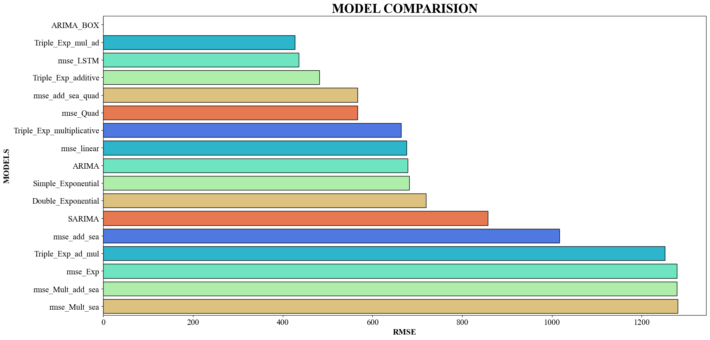

Slide 30
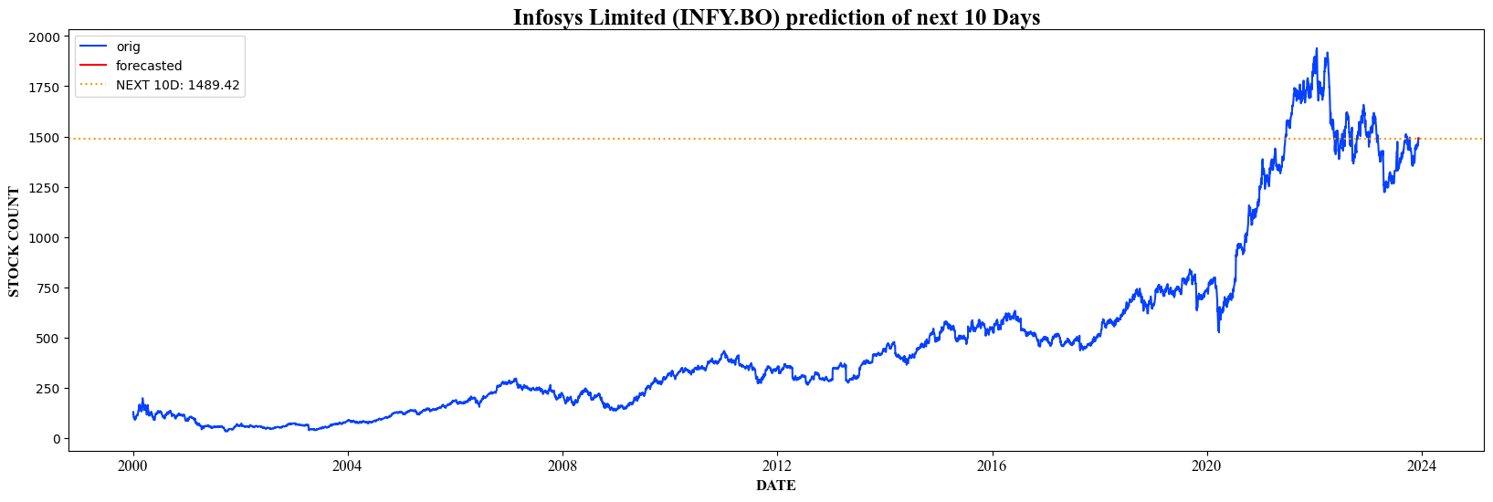
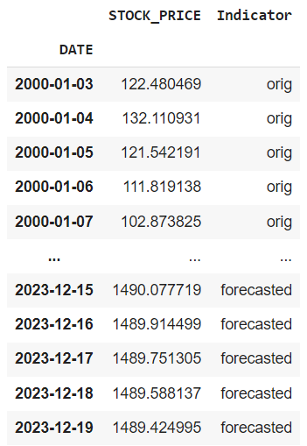
Prediction of ARIMA Model

Slide 31
Model Deployment
Deployment is the transition from a development or testing phase to a live, operational state where end-users can interact with and benefit from the system.
Deployment is a critical phase in the software development life cycle, ensuring that the developed solutions are not only functional but also reliable and accessible to the intended audience.

Slide 32
Steps for Deployment:
Deployment Environment: Anaconda, Spyder, Jupiter.
Prepare Data.
Model Export.
Build Model Serving Component.
Testing.
Documentation.
Go-Live.

Slide 33
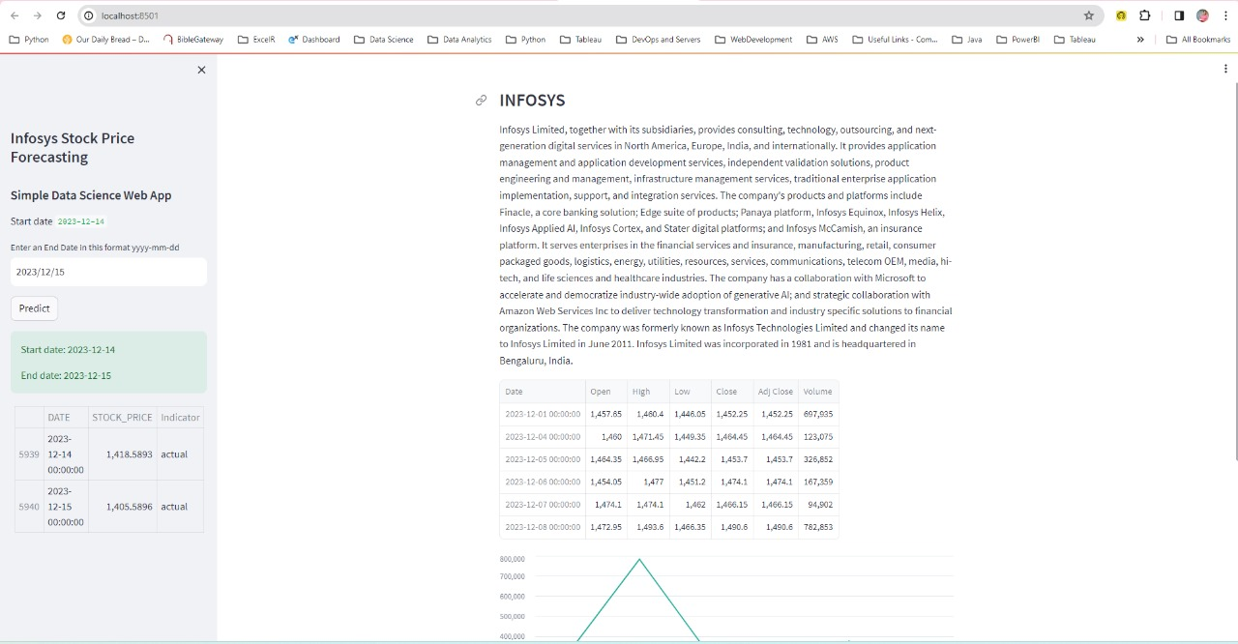
Web Page

Slide 34
Thank you

